Slide 1



Soccer PowerPoint

Slide 2

History
The history of soccer traces back to ancient ball games played in various cultures. In the Middle Ages, different regions had their own variations of soccer-like games. In the 19th century, soccer rules were codified at Cambridge University, laying the foundation for the modern game. Other clubs and schools in England and beyond developed their own sets of rules, leading to the establishment of soccer associations and leagues worldwide.

Slide 3

Professionalism
Professionalism in football emerged in the late 19th and early 20th centuries, with the adoption of paid players, formation of professional leagues, and introduction of player contracts and transfers. It transformed football from an amateur pastime to a commercialized industry, with organized competitions, structured clubs, and financial incentives for players.

Slide 4


International organization
International organizations are intergovernmental or non-governmental entities established to promote cooperation and address global issues. Examples include the United Nations (UN), World Bank, International Monetary Fund (IMF), World Health Organization (WHO), and UNESCO. These organizations facilitate collaboration among countries on various matters such as peace and security, economic development, health, education, and humanitarian aid.

Slide 5

Football around the world
Europe
Football has a rich history and a strong following in Europe, with numerous professional leagues and clubs, such as the English Premier League, La Liga in Spain, Serie A in Italy, and the Bundesliga in Germany.

Slide 6

South
America
South America is known for its passionate football culture, with countries like Brazil and Argentina producing world-renowned players and having a deep-rooted football tradition. Football is a way of life in South America, with enthusiastic fans, competitive leagues, and iconic football stadiums.

Slide 7

Africa
Football is immensely popular in Africa, with many African countries having their own domestic leagues and national teams. The sport is widely played at grassroots levels, serving as a unifying force within communities.

Slide 8


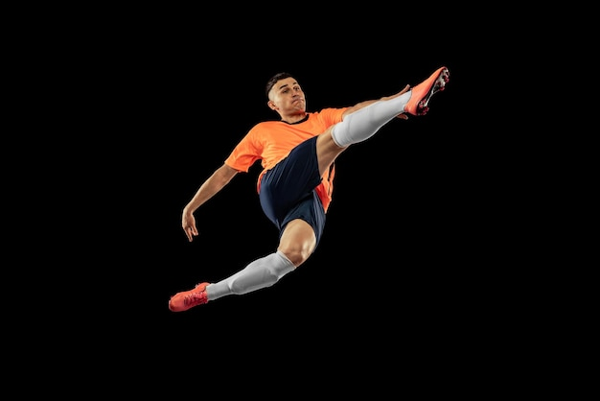
The football field is typically rectangular in shape and made of grass or artificial turf. The dimensions of the field are regulated by the sport's governing bodies and can vary, but a standard field is usually around 100-110 yards in length and 50-60 yards in width.
Equipment and field of play

Slide 9
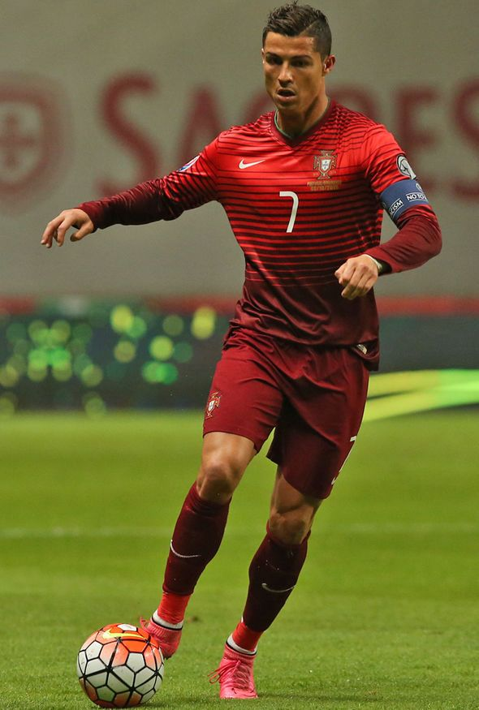


Fouls
In football, fouls are actions committed by players that are considered violations of the rules of the game. When a player commits a foul, the opposing team is typically awarded a free kick, a penalty kick, or an indirect free kick, depending on the location and severity of the foul.

Slide 10
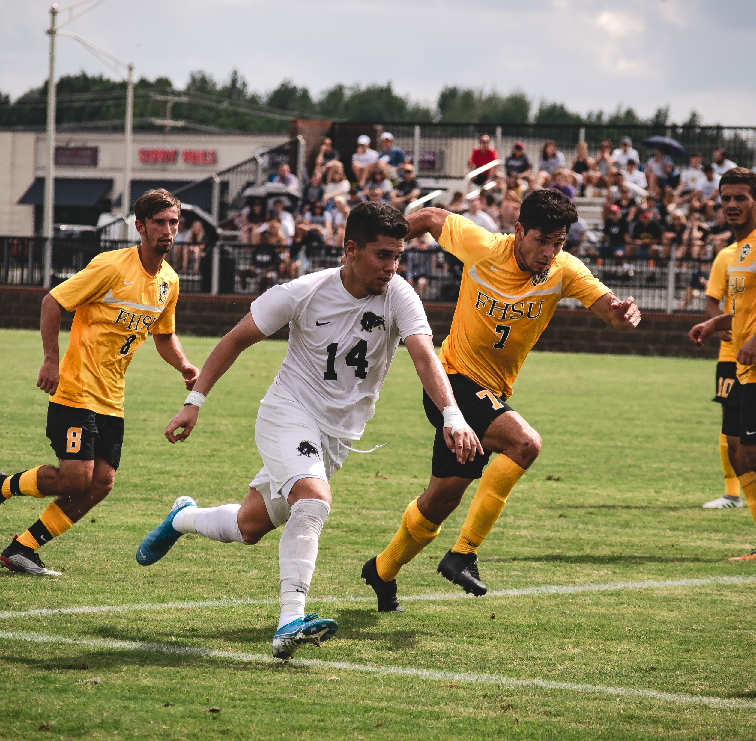
Rules
Rectangular field with goal lines and touchlines, spherical ball, 11 players per team, score by kicking ball into opponent's goal, offside when closer to goal than second-to-last defender, fouls result in free kicks/penalty kicks, yellow/red cards for misconduct, throw-ins for ball out of bounds, penalty kicks from penalty spot, fair and safe play.

Slide 11
Icons

Slide 12
Icons

Slide 13
How To Edit Shapes
You can add and edit some shapes to your presentation to present your data in a visual way.
Choose your favourite infographic and insert it in your presentation using Ctrl C + Ctrl V or Cmd C + Cmd V in Mac.
Select one of the parts and ungroup it by right-clicking and choosing “Ungroup”.
Change the color by clicking on the paint bucket.
Then resize the element by clicking and dragging one of the square-shaped points of its bounding box (the cursor should look like a double-headed arrow). Remember to hold Shift while dragging to keep the proportions.
Group the elements again by selecting them, right-clicking and choosing “Group”.
Repeat the steps above with the other parts and when you’re done editing, copy the end result and paste it into your presentation.
Remember to choose the “Keep source formatting” option so that it keeps the design. For more info, please visit Slideegg (Tips & Tricks).

Slide 14
Terms Of Use (Free Users)
If you are a free subscriber, you should credit SlideEgg by keeping the “Thank You” slide.
Kindly refer to the following slide for the Terms of Use for premium users.
You can:
Customize or edit this template
Use this template for both business and personal endeavors.
You can not:
Sell, rent, or second-license SlideEgg content or its altered version. Promulgate, unless explicitly permitted, SlideEgg content, by SlideEgg.
Incorporate SlideEgg content in any database or file online or offline.
Obtain SlideEgg content’s copyright.
Kindly refer to our Tutorial page or FAQ for advanced slide modification guidelines.

Slide 15
Terms Of Use (Premium Users)
Being a premium subscriber, you have the privilege of using this PPT template
without giving attribution to SlideEgg or keeping the “Thank You” slide.
You can:
Customize or edit this template.
Use this template for both business and personal endeavors.
Circulate or share the editable format of this template with anyone you want.
You can not:
Sell, rent or second-license SlideEgg content or the altered version of it. Promulgate or include the templates in any other services database
that performs as distribution or resale platform, unless explicitly permitted, by SlideEgg.
Incorporate the elements used in SlideEgg’s templates separately.
Obtain SlideEgg’s copyright for the elements used in this template as a logo or trademark.
Kindly refer to our Tutorial page or FAQ for advanced slide modification guidelines.

Slide 16





Thank You!
We respect your valuable time with SlideEgg!
If you have any questions, please reach us
Do you have a design request, please visit our redesign page.
CREDIT: SlideEgg created this PowerPoint template.
Let this slide be kept for attribution.
www.slideegg.com

